Slide 1
Alzheimer's Disease Prediction 🧠🔍📈
na

Slide 2




Introduction Slide (Project Goals)
BackGround
Goal 1
Alzheimer’s disease (AD) is a progressive neurodegenerative condition
Build complete ML pipeline for Alzheimer's disease prediction .
Goal 2
Goal 3
Evaluate multiple models (Logistic Regression, Decision Trees, MLP, SVM)
Identify key patient features for clinical diagnosis

Slide 3
Dataset summary
Dataset overview
34 Variables
Data Structure
Patient Information(patient), Demographic Details (Age, Gender, etc.), Lifestyle Factors (BMI, Smoking, etc.), Medical History (FamilyHistoryAlzheimers, CardiovascularDisease, etc.), Clinical Measurements(SystolicBP, DiastolicBP, etc.), Cognitive and Functional Assessments (MMSE, FunctionalAssessment, etc.), Symptoms (Confusion, Disorientation, etc.), Diagnosis Information (Diagnosis), and Confidential Information (DoctorInCharge).
All data are Row-and-column; at the beginning, there were zero missing observations.
Synthetic Alzheimer's dataset (Rabie El Kharoua)
2,149 patients
Binary classification (0=No, 1=Yes)
Class distribution: 35% Alzheimer's, 65% non-Alzheimer's

Slide 4
Data preprocessing
Splitting
Scaling
The processed dataset was then split into training and test sets (≈80%/20%) in a stratified manner to maintain the AD class ratio for evaluation
Encoding
Continuous numeric features (e.g., age, BMI) were normalized to a z-score scale to Grantee fairness by models. This standardizes the records for model fitting by putting features on comparable ranges.
Cleaning
All qualitative variables were converted to numeric form using one-hot encoding. This created a separated binary dummy column for each category (including the two columns of any binary feature).
No missing values needed removal (all features values were present). On feature with a single fixed values ("DcotorInCharge") was dropped as uninformative.

Slide 5
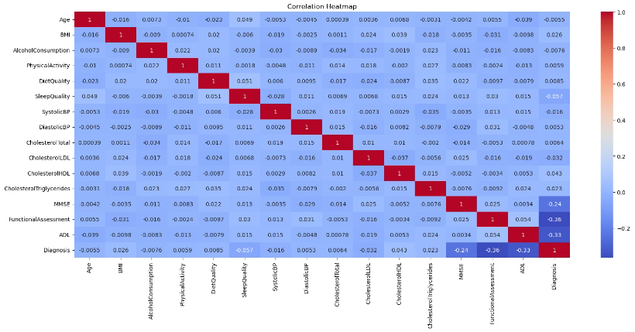
EDA Highlights (Data Exploration)
Correlation heat map of key numeric features (continuous variables) and the status for AD. Warmer color = positive correlation, cooler = negative.
We observe cognitive and function score (e.g. FunctionalAssessment, ADL) have the strongest correlations with Alzheimer's Diagnosis (inversely, around r = - 0.33 to -0.36), whereas features like age and cholesterol levels show near-zero correlation with the outcome. No pair of predictor was too highly inter-correlated (no multicollinearity issue).

Slide 6
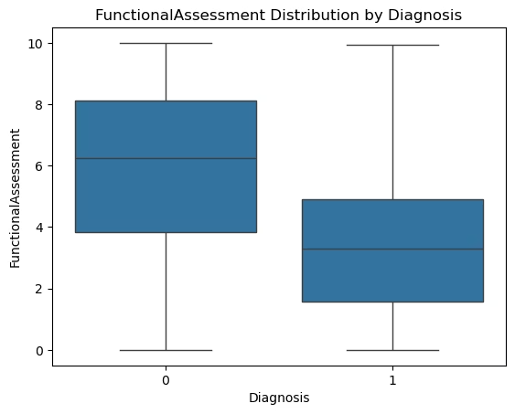
EDA Highlights (Data Exploration) Continue
FunctionalAssessment score by Diagnosis. Patients With AD (right box, Diagnosis=1) have significantly lower FunctionAssessment scores than those without AD (left box, Diagnosis=0), indicating worse daily functioning in AD patients. For example, the median score is ~4 for AD patients vs ~6 for non-Alzheimer's Diagnosis, on a 0-10 scale. A similar pattern is seen with the ADL(Activities of Daily Living) score (AD mean ~3.65 vs non-Ad ~5.71), whereas an exam like MMSE showed a smaller difference. These findings confirm that functional ability is markedly impaired in the AD group.
Symptom Frequencies
Certain symptoms were much more prevalent in those diagnosed with AD. For instance, memory complains were reported by 65 % of AD patients vs only 28 % of non-AD patients; behavior problems in 60% of AD vs 31 % of non-AD. These symptom flags are strong differentiators of AD status.
Minor Differences
Many demographic and general health factors (age, BMI, PhysicalActivity, SystolicBP, etc.) showed minimal differences between Ad and non-AD groups. Notably, having a family history of Alzheimer's did not increase risk in this dataset (possibly and artifact of synthetic data).
EDA Summary
Cognitive/functional measures and memory-related symptoms emerged as the promising features for predicting AD, whereas isolated medical history and lifestyle factors were relatively weak predictors.

Slide 7



Features Engineering Slide
Redundant Feature Removal
We dropped or consolidated features that provided little information. For example, DoctorInCharge was constant for all records (dropped), and FamilyHistoryAlzheimers was removed due to its paradoxical association and negligible effect on model performance. Similarly, a few other binary medical history features(e.g. head injury, cardiovascular disease) that showed minimal contribution were removed to streamline the model.
Random Forest Feature Selection
We applied a RandomForest-based feature importance filter to automatically select a subset of the most predictive features. Using a cross-validated SelectFromModel (threshold = median importance), the pipeline consistently retained about 16 top features. These included the key cognitive/functional assessments (MMSE, FunctionalAssessment, ADL, etc.), certain lifestyle factors(BMI, PhysicalActivity, etc.), several cholesterol measures, and behavior problem (BehavioralProblems) 0 aligning with out EDA insights.
Interaction Features
To help linear models capture non-linear relationships, we created additional features representing interactions between important factors. For example, combined indicators or product terms (like CholesterolTotal x BMI ) were introduced. These engineered features allow algorithms like logistic regression to account for combined effects of multiple variables that a decision tree or RF might capture automatically.

Slide 8
Modeling Approach Slide
Models Evaluated
We trained and tested four classification algorithms: Logistic Regression (LR), Support Vector Machine (SVM), Decision Tree (DT), and a Multi-layer Perceptron (MLP) neural network. This selection covers both simple linear and more complex non-linear learners.
Training setup
The data was split into a training set for model fitting and a hold-out test set for final evaluation (using ~1,719 train / 430 test split). We used stratified sampling to maintain class balance. Model development and tuning were done using the training data only, with 10-fold cross-validation to avoid overfitting.
Hyperparameter Tuning
We performed grid search cross-validation for each model to find optimal hyperparameters. For example: the regularization strength C for LR, kernel and C for SVM, max depth/criteria for DT, and hidden layer sizes & alpha for the MLP were tuned. We used balanced class weights or checked metrics like roc_auc to account for the flight class imbalance during training.
Evaluation Metrics
Model performance was assessed on the test set using multiple metrics - Accuracy, Precision, Recall, F1-score, ROC-AUC (Area Under Receiver-Operating Characteristic Curve) and PR-AUC(Area Under the Precision–Recall Curve). This ensures a comprehensive view: accuracy for overall correctness, F1 for balance between precision/recall, and ROC-AUC for discrimination ability, PR-AUC for discrimination under class imbalance.

Slide 9
Model Evaluation Slide (Results Comparison)
Overall Results
Model
Accuracy
F1-score
ROC-AUC
The Decision Tree achieved the highest predictive performance, followed closely by the MLP neural network, while the SVM and Logistic Regression trailed behind. The table below summarizes the test performance for each model:
Decision Tree (DT)
93.7%
0.911
0.921
MLP (Neural Net)
83.7%
0.768
0.899
Logistic Reg. (LR)
80
0.751
0.885
SVM (Linear kernel)
79.5%
0.740
0.883
The Decision Tree outperforms other models in all metrics (highest accuracy, F1, and ROC-AUC). The MLP is the second-best model, while the linear classifiers (LR and SVM) show lower accuracy and F1 (~74-75%).
Notably, the DT and MLP have close ROC_AUC values (~0.92 vs 0.90), indicating both capture the ranking of predictors well. However, the DT's substantially higher F1 (0.91 vs 0.77) mean it achieves a better balance between precision and recall on the test data.
This validates that the tree model leverage patterns in the data that other models (especially the linear ones) could not easily capture, leading to superior overall performance.

Slide 10
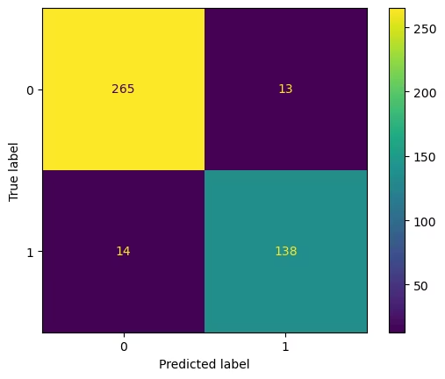
Best model Deep Dive - Decision Tree
Confusion matrix the Decision Tree on the test set (430 samples). The model correctly predicted 265 out of 278 non-AD patients and 138 out of 152 AD patients, with 13 false positives (non-AD predicted as AD) and 14 false negatives (AD predicted as non-AD).
Performance
The Decision Tree attained ~93.7 accuracy, with high precision (91.4%) and recall (90.8%) on the test set. This means it identified most AD cases while keeping false alarms low. The errors are relatively balanced (14 missed AD vs 13 mislabeled healthy), indicating no severe bias towards one class.

Slide 11
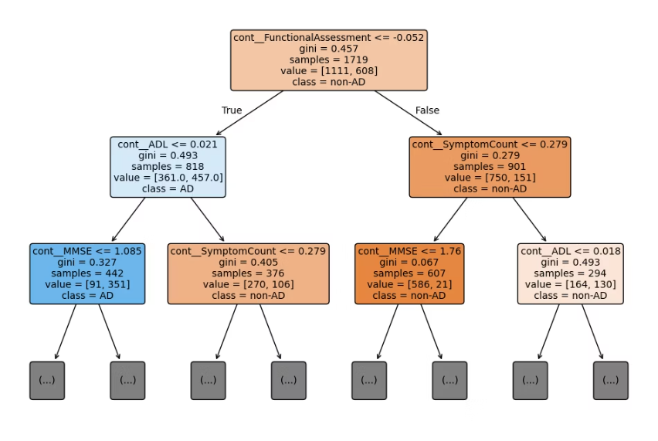
Best model Deep Dive - Decision Tree Continue
Interpretability
The decision tree offers excellent transparency by visualizing the classification process. The primary split on Functional Assessment (≤ -0.052) followed by ADL (Activities of Daily Living) splits effectively mirrors clinical understanding of AD progression. The model prioritizes functional assessment, then examines ADL scores to determine AD risk, matching known clinical indicators of cognitive decline. This alignment with domain knowledge makes the model intuitive for healthcare practitioners.
.
Simplicity vs. Accuracy
tree achieves strong performance despite its simplicity. Its strength lies in capturing non-linear relationships between variables - particularly how Functional Assessment interacts with ADL and Symptom Count thresholds. The clear if-then decision rules allow clinicians to trace exactly why a specific prediction was made, building trust in the model's outputs. This transparency is particularly valuable in medical contexts where understanding the reasoning is essential.
.
Insights
The strongest predictors appearing in the tree's logic correspond to what we expected: e.g., splitting on functional assessment effectively isolates a high-risk group

Slide 12
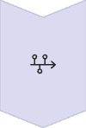
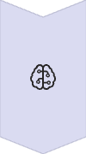
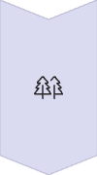


Conclusion & Key Takeaways Slide
Successful ML Pipeline
WE built a complete machine learning pipeline for Alzheimer's prediction, from data cleaning to model evaluation, on a synthetic dataset of over 2,100 patients, the pipeline achieved high accuracy in distinguishing AD vs. non-Ad individuals, demonstrating the potential of ML for early Alzheimer's detection in principle.
Key predictors
The most influential features were cognitive and functional test scores and memory- related symptoms. In particular, low FunctionalAssessment/ADL scores and reported memory problem strongly signaled Alzheimer's, whereas demographic and general health factors were less useful. This aligns with medical expectations that cognitive decline and memory issues are central indicators of AD.
Model Comparison
Among the models tested, a Decision Tree provided the best performance ( ≈ 94 % accuracy, F1 ~0.91) while also being highly interpretable. The tree's ability to capture interactions effects gave it an advantage over logistic regression and SVM, which struggled with complex patterns in the data. The neural network (MLP) also performed better than the linear models, but it acts as a "black box" in contrast to the transparent decision tree.
Implications
The strong results from the decision tree suggest that a few key questions/test (ADL, functional ability score, etc.) might suffice for an effective early screening tool. Because the model is easy to interpret, it could be used by clinicians to explain predictions - an important factor for trust in AI in healthcare.
Next step
Since these findings are based on Synthetic data, the next step is to validate the approach on real patient datasets to ensure the model generalizes to actual clinical settings. We also plan to explore ensemble methods (like Random Forests or boosted trees) which could further improve predictive performance by combining multiple decision trees. Finally, incorporating longitudinal data (patient data over time) or additional biomarkers could be investigated to enhance early prediction of Alzheimer's disease.

